Slide 1


TRAINING DAY 3

Slide 2
AGENDA
BODS Performance Management - Analysis / Metadata Management
BODS Performance tuning techniques
Introduction to the metadata tables
Default options to increase performance
SAP Data Intelligence Overview
SAP SDI Overview

Slide 3
METADATA MANAGEMENT
SAP Business Objects Metadata Management is a Web-based application that provides an integrated view of metadata and their relationships across all of the products used in a Business Intelligence project.
Metadata is definitional data that provides information about data managed within an
application or system. Metadata includes the following information:
Attributes such as name, size, data type
Structures such as length, fields, columns
Properties such as where it is located, how it is associated, ownership
Descriptive information about the context, quality and condition, or characteristics of the data

Slide 4
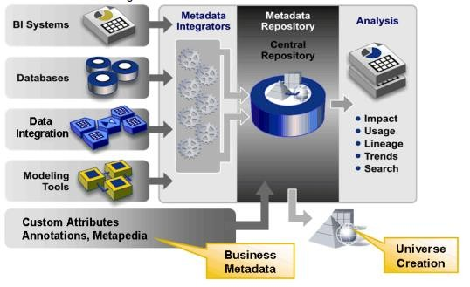
METADATA MANAGEMENT

Slide 5
METADATA MANAGEMENT
As the following diagram illustrates, the software collects and unifies metadata from data sources such as:
Business Intelligence (BI) systems
Databases
Data Integration technologies such as SAP BusinessObjects Data Services and SAP Business Objects Data Federator
Modeling utilities

Slide 6
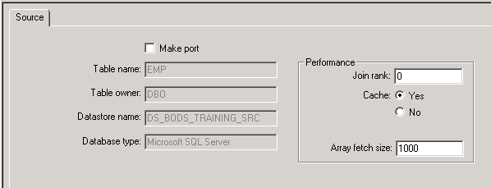
SOURCE-BASED PERFORMANCE OPTIONS
Join ordering
Minimizing extracted data
Using array fetch size

Slide 7
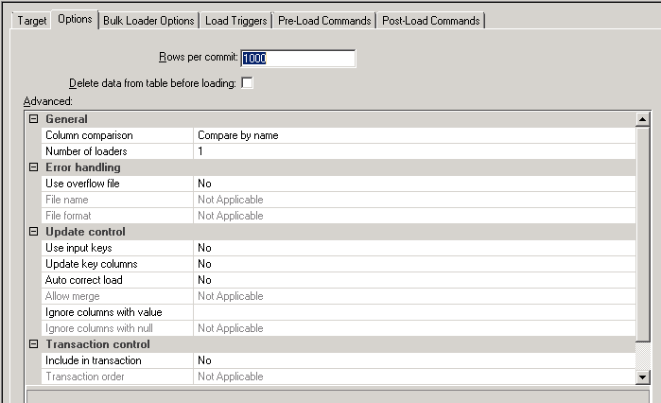
TARGET-BASED PERFORMANCE OPTIONS
Loading method
Rows per commit

Slide 8
JOB DESIGN PERFORMANCE OPTIONS
Loading only changed data
Minimizing data type conversion
Minimizing local conversion
Precision in operations

Slide 9
USING BULK LOADING
SAP Business Objects Data Services supports capabilities present in Oracle, Microsoft SQL Server, HP Neoview, Informix, DB2, Netezza, Sybase ASE, Sybase IQ, and Teradata that enable you to load data in bulk rather than using SQL statements.
Some general considerations when using bulk loading are:
You specify bulk-loading options on the Data Services target table editor in the Bulk Loader Options tab.
If you are using bulk loading, parallel loading is available only in the Oracle and
Informix environment.
When you use a template table, bulk loading is disabled.

Slide 10
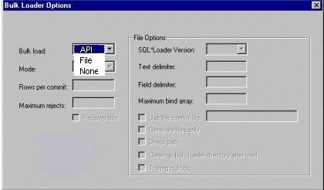
BULK LOADING IN ORACLE
You can bulk load to Oracle using an API or a staging file.

Slide 11
BULK LOADING IN MS SQL SERVER
SAP BusinessObjects Data Services supports Microsoft SQL Server bulk loading through the SQL Server ODBC bulk copy API.
When loading to SQL Server, the client caches rows until it either fills a network packet or reaches the commit size (regardless of whether the packet is full). Then the client sends the packet to the server.
You can affect performance by tuning commit size and network packet size.
You can change these sizes on the Bulk Loader Options tab for SQL Server:
Rows per commit: This option lets you specify the number of rows to put in the cache before issuing a commit.
Network packet size:This option lets you specify network packet size in kilobytes.
The default packet size is 4 kilobytes.

Slide 12
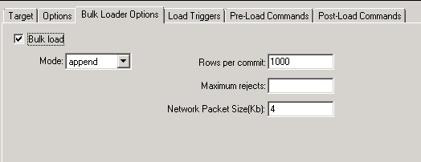
BULK LOADING IN MS SQL SERVER

Slide 13
DISTRIBUTING DATA FLOW EXECUTION
This distribution of data flow execution provides the following potential benefits:
Better memory management by taking advantage of more CPU power and physical memory
Better job performance and scalability by taking advantage of grid computing.

Slide 14
USING PARALLEL EXECUTION
You can set transformation,
SAP BusinessObjects Data Services to perform data extraction, and loads in parallel by setting parallel options for sources
,transforms, and targets. In addition, you can set individual data flows and work flows to run in parallel by simply not connecting them in the workspace.
If the Job Server is running on a multi-processor computer, it takes full advantage of available CPUs.
Note that if you have more than eight CPUs on your Job Server computer, you can increase Maximum number of engine processes to improve performance.
To change the maximum number of parallel engine processes, use the Job Server
options (Tools > Options> Job Server > Environment).

Slide 15
DEGREE OF PARALLELISM
Degree Of Parallelism (DOP) is a property of a data flow that defines how many times each transform defined in the data flow replicates for use on a parallel subset of data.
If there are multiple transforms in a data flow, SAP BusinessObjects Data Services chains them together until it reaches a merge point.
You can run transforms in parallel by entering a number in the Degree of Parallelism box on a data flow's Properties window.
The number is used to replicate transforms in the data flow which run as separate threads when the Job Server processes the data flow.

Slide 16
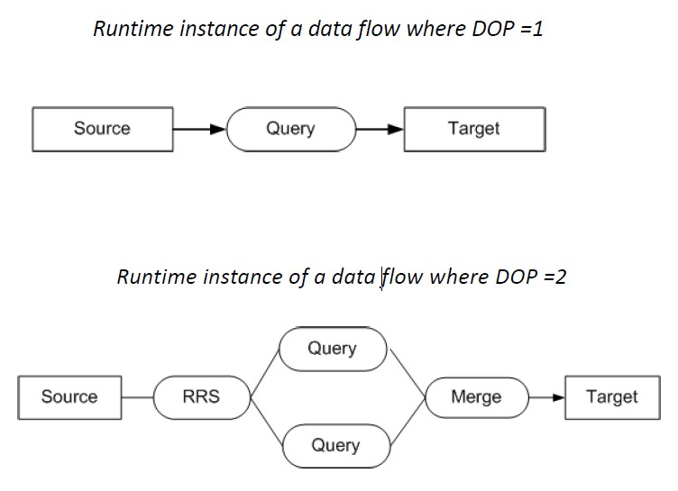
DEGREE OF PARALLELISM EXAMPLE

Slide 17
BODS PERFORMANCE TUNING TECHNIQUES
The performance
of an ETL job depends on the factors that contribute
to the
perform
performance in an ETL task. They are −
Source Data Base : Source database should be set to the Select statements quickly
Source Operating System : Source Operating System should be configured to read
the data quickly from the disks.
Target Database : Target Database must perform INSERT and UPDATE quickly. This can be done by
Disabling the Archive logging.
Disabling the Redo logging for all tables.
Maximizing the size of the shared buffer.
be configured to

Slide 18
BODS PERFORMANCE TUNING TECHNIQUES
Target Operating System : Target Operating System has to be configured in order to write the data to the disks quickly. You can turn on asynchronous I/O to make the Input/output operations as fast as possible.
Network : Network bandwidth should be enough to transfer the data from source to
target system.
BODS Repository Database : To improve the performance of BODS jobs, Monitor Sample Rate can be performed
Monitor Sample Rate : In case you are processing a large amount of data set in an ETL job, monitor Sample Rate to a higher value to reduce the number of I/O calls to the log file thereby improving the performance.
Job Server OS : In Data Services, one data flow in a job initiates one ‘al_engine’ process, which initiates four threads. For maximum performance, consider a design that runs one ‘al_engine’ process per CPU at a time

Slide 19

INTRODUCTION TO THE METADATA TABLES
The metadata for the mappings created will get stored in the repository.
Data Services provides full access to the repository metadata used by the applications you create. To access this metadata either manually enters SQL SELECT statements or open the metadata reporting tool.
The following set of tables in the Data Services repository stores the statistics that the audit feature collects.

Slide 20
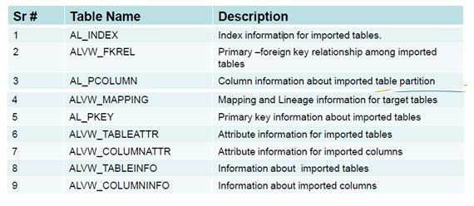
INTRODUCTION TO THE METADATA TABLES
The below set of tables (prefixed by AL_) and views (prefixed by ALVW_) will capture the information about the metadata imported into Data Services from external databases and applications (such as Oracle, PeopleSoft, and SAP ERP or R/3).

Slide 21
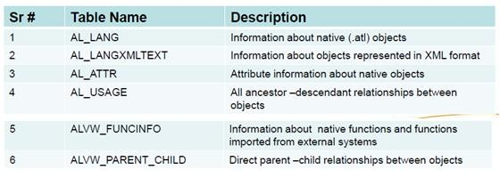
INTRODUCTION TO THE METADATA TABLES
The below set of tables and views capture information about built-in metadata objects used by Data Services and the relationships between those objects.

Slide 22
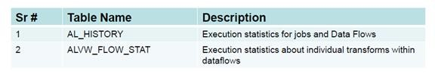
INTRODUCTION TO THE METADATA TABLES
These following tables and views contain information about the run-time statistics of Data Services jobs and data flows.

Slide 23
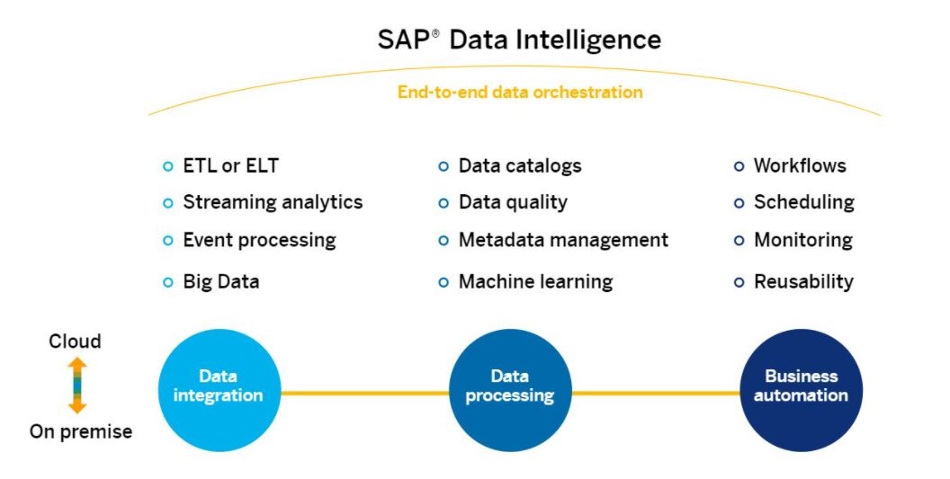
Introduction to SAP Data Intelligence
-Turn data chaos into data value with Data Intelligence
What is SAP Data Intelligence?
SAP Data Intelligence is a comprehensive data management solution.
As the data orchestration layer of SAP’s Business Technology Platform, it transforms distributed data sprawls into vital data insights, delivering innovation at scale.
This product is known to be one of the robust product under SAP Integration suite. Provides Data Integration, Data Management & Data Processing –A complete solution.
Features & Connections with various sources

Slide 24

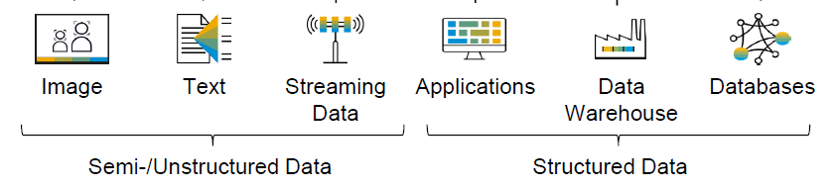
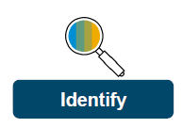
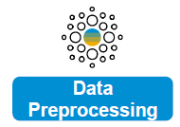
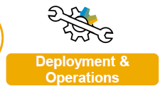
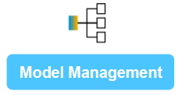








SAP Data Intelligence Overview
Data Provisioning
Data Science Lifecycle Management
Security
Monitoring
Maintenance
Data Governance
Scalability
Flexibility
Control over Artifacts
Roles, Policies
Audit Logs
Authentication & Authorization
Workflow & Operations
Logging & Tracing
Resource Consumption
Diagnosis Info
Data Discovery, Profiling
Data Cataloguing
Data Quality Rules
Track Data Source Usage
Kubernetes & Docker
Distributed Runtime
Massive Parallelization
Resource Isolation
Customization
Ready to use Functional Services
Workflow
Management
Prototyping
Custom Workflows/Templates
Building Custom Models
Graph Snippets, Operators
Data Connections
Image Based Solutions
HANA ML(PAL, APL)
Text Based Solutions
Auto ML
Automating Workflows
Cron Based Scheduling
API based Triggers
On-Demand Triggering
Experimentation Templates
400 Predefined Operators
Ready-to-use Models
Out-of-the-box Deployment

Slide 25
Introduction to SAP HANA Smart Data Integration
SAP HANA smart data integration and SAP HANA smart data quality load data, in batch or real-time, into HANA (on premise or in the cloud) from a variety of sources using pre-built and custom adapters.
Prior to Hana SPS09 SAP suggested to use different tools to get data into Hana, now SDI is available on SAP Cloud Platform and every HANA database since HANA SPS09.
SDI has two main components.
1. Data Provisioning Server (DPServer):
DPServer is natively available in the HANA database. We need to activate the DPServer in the HANA configuration.
2. Data Provisioning Agent (DP Agent):
The Data Provisioning Agent manages all SDI Adapters and connections to HANA database. It acts as the communication interface between HANA and the Adapter. The DP Agent version must match with the HANA version.
On this agent,different types of adapters are deployed, these adapters will take care of the communication between the HANA database and the source systems.

Slide 26
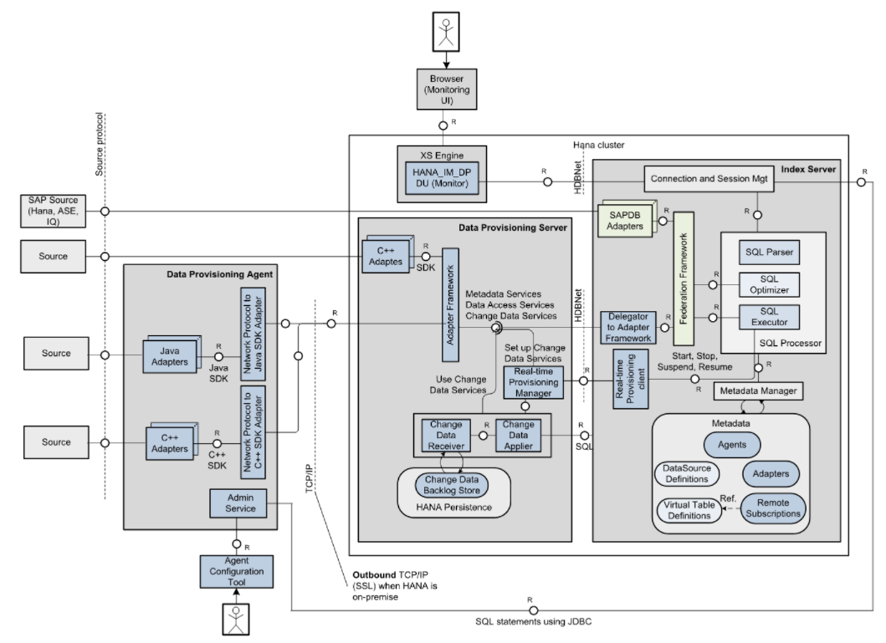
HANA Smart Data Integration Architecture

Slide 27
Thank You

